Slide 1
Honors Contracts
By: Natalye Harpin, Honors Coordinator

Slide 2
Table of Contents
3
Which Students are Eligible?
10
How to Structure Honors Option
4
Why Honors Contracts?
11
Honors Transfer Council of CA
5
What’s in it for You/Them
13
Completing an Honors Degree
8
Who Submits What?
14
Deadlines by Term
9
Coordinator’s Role
15
Questions?

Slide 3
Who is Eligible Among My Students?
Honors Contacts
Students must have a minimum Grossmont GPA of 3.2 and at least 12 units
  New students must submit application materials to Natalye Harpin for approval and documentation. Continuing students will be verified to ensure their GPA is still at least 3.2.
  Former high school students may submit transcripts showing 3.2 GPA if they have not completed 12 units at Grossmont yet
Student must be eligible for (or have successfully completed):
  ENGL 120
  MATH 103
Once established, your contract with the student will be sent to Natalye (via email) to verify work load (this can be done ahead of time!) for Honors completion

Slide 4
Why Honors Contracts?
Honors Contracts
Allows a student to build the contract with their instructor for the extra work
  Generally adding an extra ~20% workload for the honors student is accepted as them having ‘earned’ honors credit
  Students must maintain a letter grade of “B” to complete the course as Honors
A student can opt-out at any time, without having to leave an entire section of a class
  (for example, if the entire course was an Honors section, then they may
  have to drop and potentially miss out on credit)
Creates opportunities for students to dive more into content depth
  Whereas our section courses provide breadth, this can open a research interest to a student related to the course. It also grows their understanding of what work is done in the fields of the classes they are taking

Slide 5
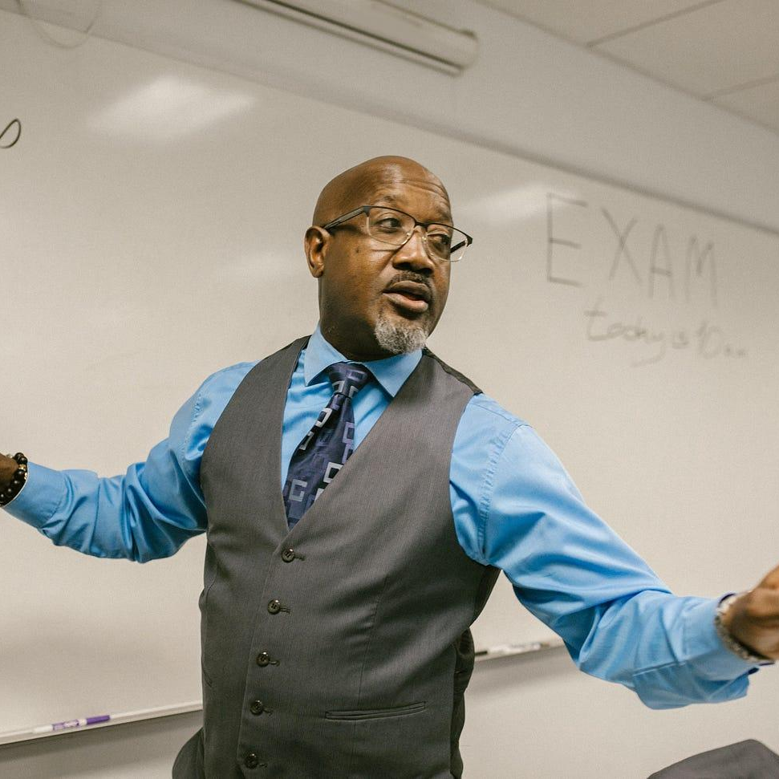


What’s in it for Me?! (Faculty)
Honors Contracts
Flexibility
Experience
Community
Because you can offer this to all of your students, it does not limit this for only faculty who are chosen to teach honors sections
For either new or seasoned faculty, this offers the opportunity to expand in areas of your syllabus you may not always be able to
Faculty can become involved in HTCC events (see slide), and network within other community colleges

Slide 6
This is voluntary for all instructors who wish to participate. It is not required of you to participate if a student asks. If you have any questions, please reach out to Natalye ☺

Slide 7


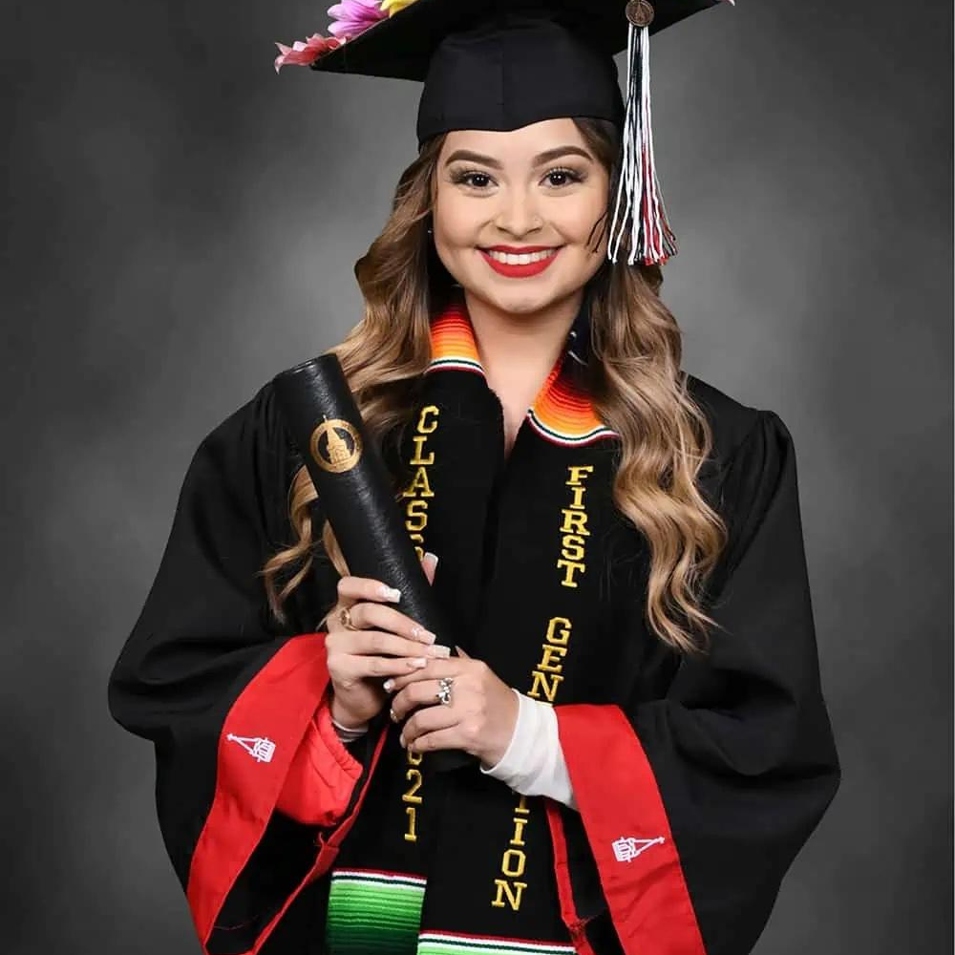
What’s in it for Them?! (Students)
Honors Contracts
Professional Development
Mentorship & Networking
Transfer Guarantees
Students can gain a deeper understanding of the field of study with their honors contract, and help unlock their academic passion for something new
By working with faculty who offer contracts, they are able to build an academic portfolio that they can use as they transfer, or transition into their field of work
By completing 18 units of Honors credit, they are eligible to transfer to four-year colleges that have a transfer considerations established via the HTCC, of which Grossmont is a member.

Slide 8
Who Submits What?
Student Responsibility
Instructor Responsibility
Student submits their signed Honors Contract (has their and your signature) to Coordinator by the deadline
Complete the honors work, and maintain a minimum of a “B” in your course.
Sign the student’s Honors Contract
Give Honors Contract syllabus addition to student, to submit with their packet to Coordinator
Inform Coordinator of their successful completion (or not) during or at the end of the semester, including their Final grade

Slide 9
Coordinator’s Role (Natalye)
Approve extra workload that Honors option students will complete.
Determine student eligibility to participate in Honors Program, approve their application.
Collect signed Honors Contracts each term for processing and approval (from student)
Collect Final Grades for students who complete honors contract each term (from instructor)
Work with A&R to determine maintained eligibility, and give honors notation on transcript upon course completion
Approve students who meet all requirements for Honors Diploma upon graduation

Slide 10
How to Structure the Honors Option
Honors Contracts
Honors courses should require about 20% extra workload for students who are in contract with the instructor
  Ex: is a class operates with 400 total points, the honors student should complete another 80 points worth of assignments
Flexibility
  There is no set requirement for what you have students do for that 20%, so long as it is pedagogically sound. You can have them do a project, lead class discussions, do writing assignments with supplemental materials/authors that coincide with content themes for your class, or a comprehensive portfolio that is turned in at the end of the semester
      These will vary by discipline. But it should be something that is meaningful, challenging, and relevant.

Slide 11

Honors Transfer Council of CA (HTCC)
Honors Contracts
Partnership of CA community colleges, that establish transfer consideration agreements for the CC’s within their network and for students who complete an honors degree at the CC. They host an annual conference (usually in Orange County) for students completing research projects
HTCC Website Here

Slide 12
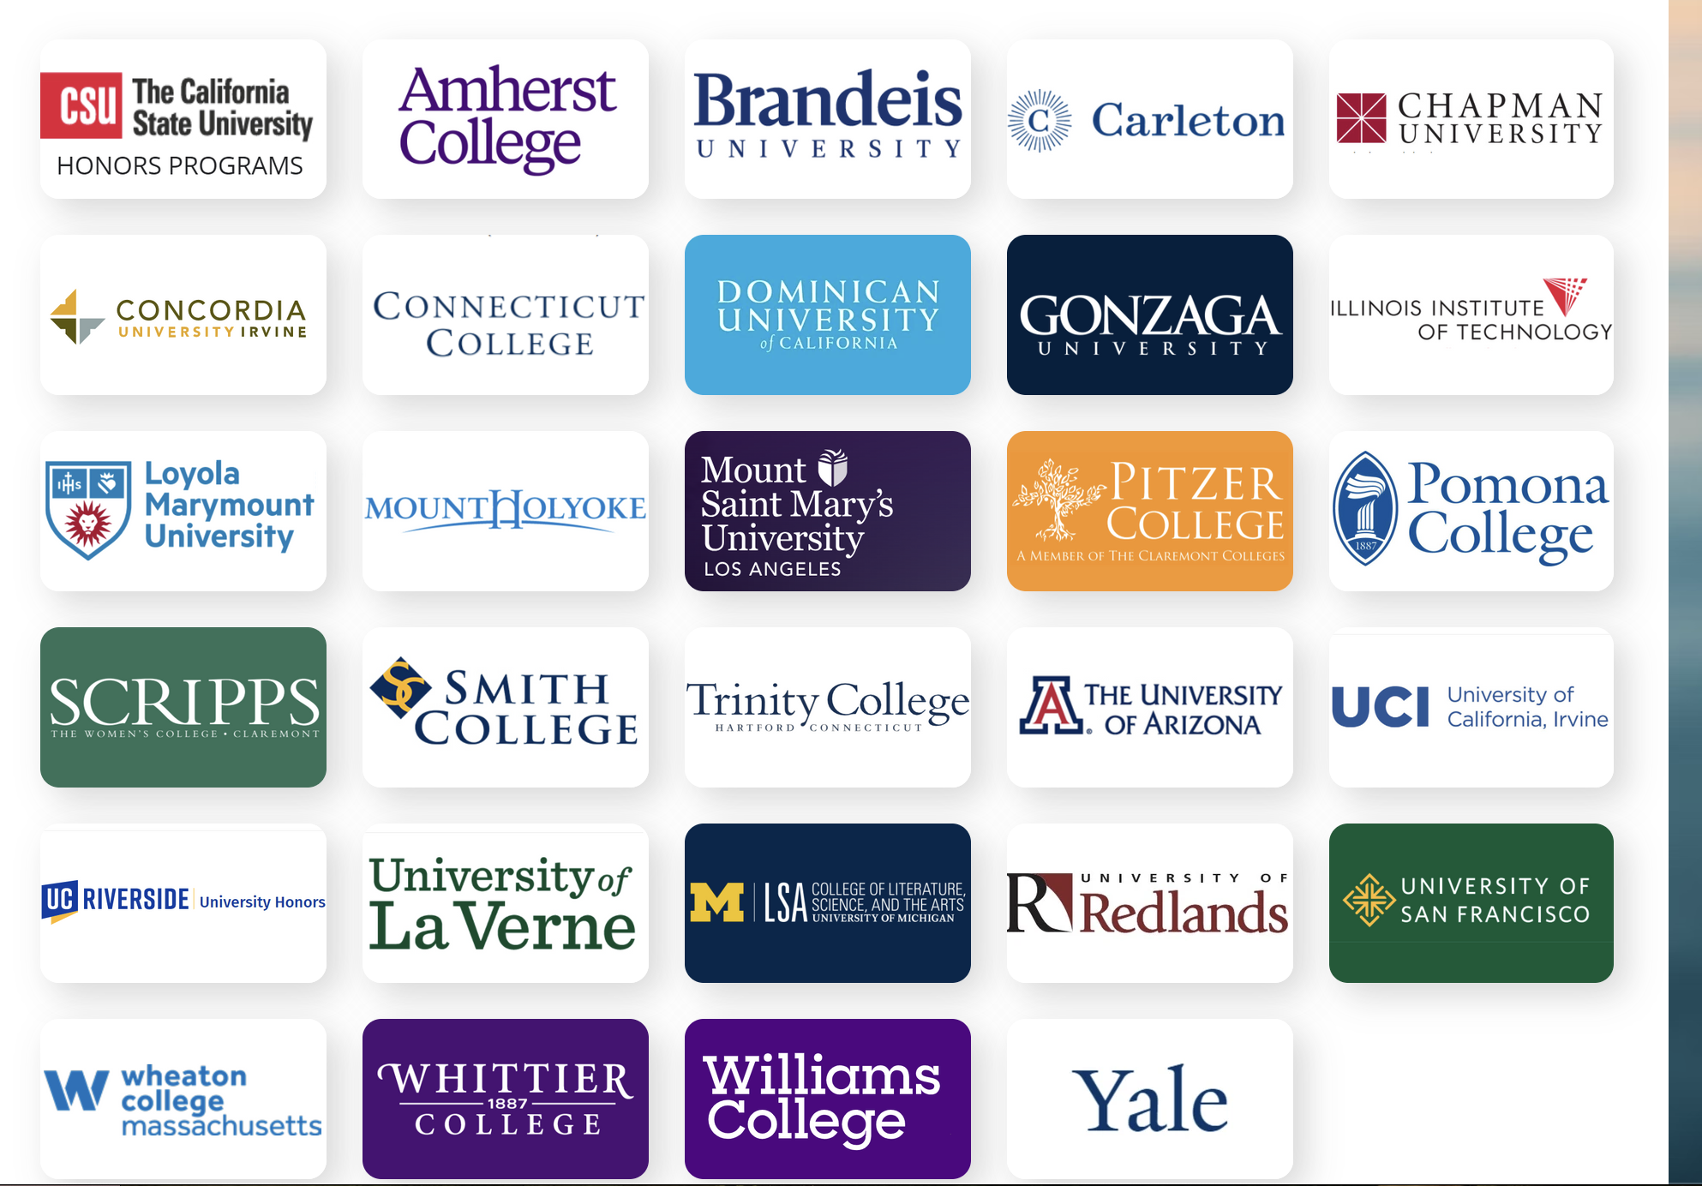

Slide 13

What is the Honors Degree?
Honors Contacts
Students who successfully complete 18 units of Honors will receive an Honors Diploma from Grossmont, which is a high distinction.
After each term, final grades of honors students should be reported to Natalye, who will send them to Academic Advising for notation on the student’s transcript

Slide 14
Deadlines by Term
Honors Contacts
Winter Intersession – Friday, Week 1
Fall/Spring Regular Term (14-16 weeks) – Friday, Week 3
Fall/Spring 8 week course – Friday, Week 2
Summer Session - Friday, Week 2
It is always best to detail the extra coursework being assigned to Honors students with Coordinator ahead of this date, to ensure that it is approved on time. This may delay or prevent student participation if postponed.

Slide 15
Still Have Questions?
Honors Contracts
Check out our webpage here!
Contact Natalye Harpin (natalye.harpin@gcccd.edu) or at
ext. 7557

