Slide 1
Honors Contracts
Natalye Harpin, Honors Coordinator

Slide 2
Table of Contents
3
Which Students are Eligible?
9
Honors Transfer Council of CA
4
Why Honors Contracts?
10
Transfer Partners
5
What’s in it for Me/Them
11
Completing an Honors Degree
7
How to Structure Honors Option
8
What Should Be in the Honors Packet

Slide 3
Who is Eligible Among My Students?
Honors Contacts
Students must have a minimum Grossmont GPA of 3.2 and at least 12 units
  New students must submit application materials to Natalye Harpin for approval and documentation. Continuing students will be verified to ensure their GPA is still at least 3.2.
  Former high school students may submit transcripts showing 3.2 GPA if they have not completed 12 units at Grossmont yet
It is recommended (but not required) that students be prepared for English & Math requirements for the institution they wish to transfer to.
Once established, your contract with the student will be sent to Natalye (via email) to verify work load (this can be done ahead of time!) for Honors completion

Slide 4
Why Honors Contracts?
Honors Contracts
Allows a student to build the contract with their instructor for the extra work
  Generally ~20% extra workload is accepted as being earned for honors credit
A student can opt-out at any time, without having to leave an entire section of a class
  (for example, if the entire course was an Honors section, then they may
  have to drop and potentially miss out on credit)
Creates opportunities for students to dive more into content depth
  Whereas our section courses provide breadth, this can open a research interest to a student related to the course. It also grows their understanding of what work is done in the fields of the classes they are taking

Slide 5
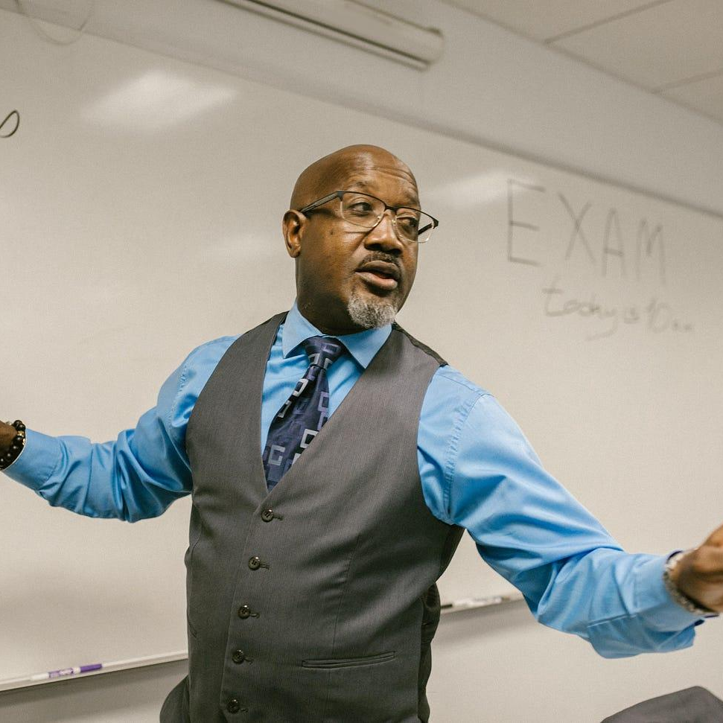


What’s in it for Me?! (Faculty)
Honors Contracts
Flexibility
Experience
Community
Because you can offer this to all of your classes, it does not limit this for only faculty who are chosen to teach honors sections
For either new or seasoned faculty, this offers the opportunity to expand in areas of your syllabus you may not always be able to. It also allows students to get into the depth of what is studied in your field discipline.
Faculty can become involved in HTCC events (see slide), and network within other community colleges

Slide 6


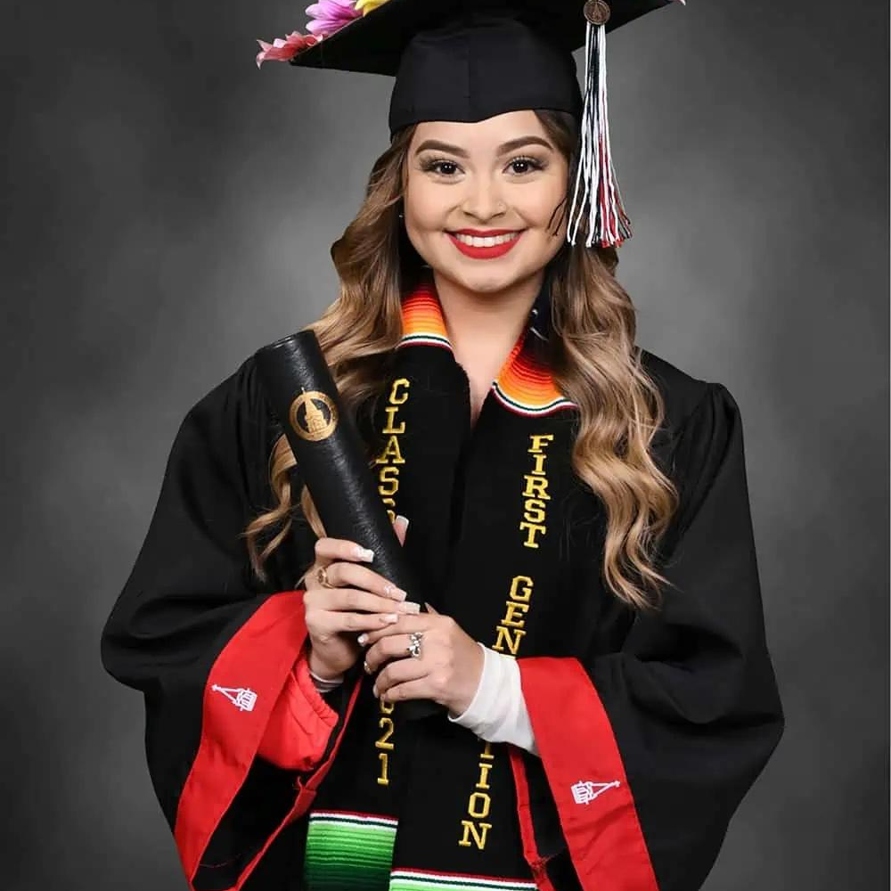
What’s in it for Them?! (Students)
Honors Contracts
Professional Development
Mentorship & Networking
Transfer Guarantees
Students can gain a deeper understanding of the field of study with their honors contract, and help unlock their academic passion for something new
By working with faculty who offer contracts, they are able to build an academic portfolio that they can use as they transfer, or transition into their field of work
By completing 18 units of Honors credit, they are eligible to transfer to four-year colleges that have a transfer considerations established via the HTCC, of which Grossmont is a member.

Slide 7
How to Structure the Honors Option
Honors Contracts
Honors courses should require a minimum 20% extra workload for students who are in contact with the instructor
  Ex: is a class operates with 400 total points, the honors student should complete at least another 80 points worth of work
Flexibility
  There is no set requirement for what you have students do, so long as it is pedagogically sound. You can have them do a project, research papers, lead class discussions, do writing assignments with supplemental materials/authors that coincide with each content module for your class, etc.
  These will vary by discipline. But it should be something that is meaningful, challenging, and relevant.

Slide 8
What Should Be in the Honors Packet?
On the Contract
In the Packet
Circle the numbers that align with what you will have the student do as part of their Honors work
Clearly articulate anything on the bottom lines that students are doing, such as specific assignments you want to highlight
Signatures for both the faculty and the student
Signed Honors contract
Regular course syllabus with Honors addendum (reflecting the 20% more workload)
Student unofficial transcript

Slide 9

Honors Transfer Council of CA (HTCC)
Honors Contracts
Partnership of CA community colleges, that establish transfer consideration agreements for the CC’s within their network and for students who complete an honors degree at the CC. They host an annual conference (usually in Orange County) for students completing research projects
HTCC Website Here

Slide 10


Slide 11

What About the Honors Degree?
Honors Contacts
Students who successfully complete 18 units of Honors units will officially have completed the Honors Program. This is separate from the Honors Diploma, which has a different set of requirements.
After each term, final grades of honors students should be reported to Natalye, who will send them to Academic Advising for notation on the student’s transcript.

Slide 12
Explaining the Difference
Can students do both? YES!!!!
Honors Program
Honors Diploma
Student completes 18+ units of coursework with an Honors addendum, meeting all other requirements (GPA, final grade, etc.)
Student is eligible for scholarship/transfer opportunities via the HTCC
Does not guarantee an Honors Diploma at Graduation
Transfer partners verify Honors Program students with the Coordinator when a student applies for transfer.
Separate GPA requirement
Student not eligible for HTCC transfer partnerships & scholarships
Does not mean student completed the “Honors Program” - this can only be certified via the Program Coordinator/HTCC Liaison (Natalye)

Slide 13
Still Have Questions?
Honors Contracts
Check out our webpage here!
Contact Dr. Natalye Harpin (natalye.harpin@gcccd.edu) or at ext. 7557

