Slide 1
Reimagining Global Learning with Equity and Courage: The Pan-African Virtual College (PAVC)
Thursday April 9, 2026 – 10:45am-12:00pm
Notes:
Robert

Slide 2
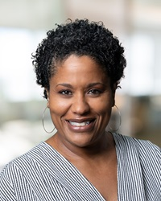
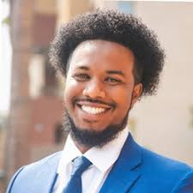
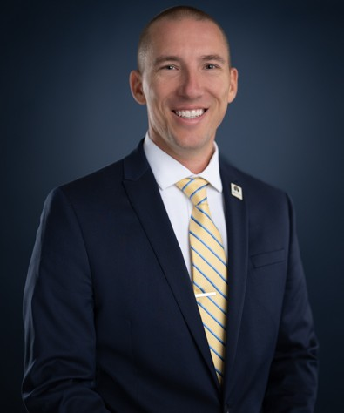
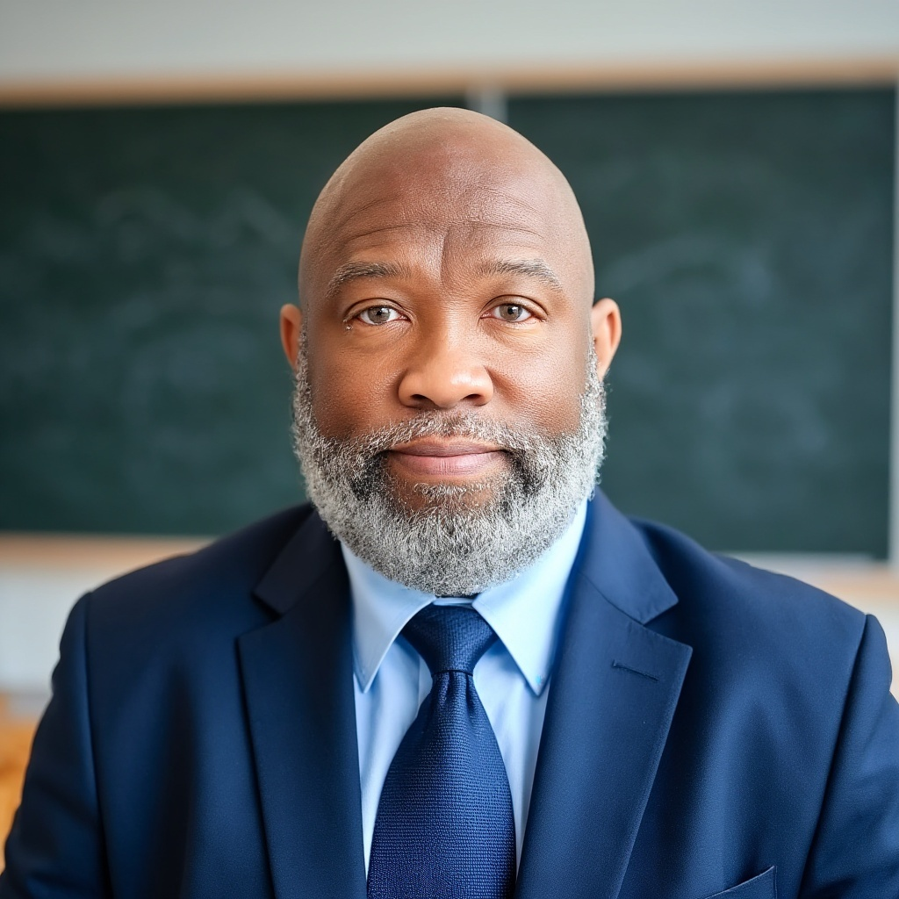
Presenters
Abdimalik Buul, Ed.D.
Vice President, A2MEND
Visiting Executive of Institutional Equity, Innovation, and Strategic Impact, CCCCO
Gina Browne
Vice Chancellor of Program Operations
& System Initiatives, CCCCO
Garrick Grace, Ph.D.
Director of Professional Development
California Virtual Campus (CVC)
Robert L. Stewart Jr.
Vice President, ASCCC
Notes:
All

Slide 3
Session Description
Global education should not be a privilege; it should be a solid promise. This session invites faculty and others to explore how the California Community Colleges Chancellor’s Office (CCCCO) Study Abroad at Home Initiative, in partnership with the California Virtual Campus (CVC) and the African American Male Education Network & Development (A2MEND)’s Pan-African Virtual College (PAVC), is redefining access to international education across the California Community Colleges. Through a lens of transformational love, equity, and courage, presenters will share how virtual global classrooms can affirm student identity, expand cultural understanding, and foster meaningful academic engagement. Participants will gain insights into curriculum integration, partnership development, professional development and a scalable model that increase access to global learning for every student.
Notes:
Robert

Slide 4
Session Goals
Welcome: Framing the Moment
What is the CCCCO Study Abroad at Home Initiative?
What is the A2MEND Pan-African Virtual College (PAVC)?
Discuss equity barriers in traditional study abroad models and how virtual global learning can address those barriers.
Discuss the role of the California Virtual Campus (CVC)
Role of the Academic Senate for California Community Colleges
Q&A
Notes:
Robert

Slide 5
Framing the Moment
Global education is not a luxury; it is a matter of equity.
Global education has traditionally been inaccessible to many California Community College students due to cost, work, family obligations, and systemic barriers.
Global education has too often been treated as enrichment……..for some.
We are here to reframe it as a right…….for all.
Caring for student’s full humanity shows Love
Students can experience Joy by expanding their world
We show Courage in redesigning systems on Purpose that result in true Equity for all students
Study Abroad at Home + PAVC redefines access by bringing global learning directly into our classrooms
Notes:
Robert

Slide 6
Equity in Access, Equity in Success, and Equity in Support
Expanding equitable access to global learning through innovation, partnership, and purpose.
Advance Equity: Remove barriers to global learning through virtual, inclusive models
Drive Student Outcomes: Accelerate baccalaureate attainment and prepare students for a global workforce
Shape the Future of Learning: Leverage technology and AI to scale transformative, intercultural experiences
Equitable Baccalaureate Attainment | Equitable Workforce & Economic Development | AI & the Future of Learning
Notes:
Gina

Slide 7
Study Abroad at Home Framework
A Practical, Equity-Centered Model for Global Engagement
Global learning embedded directly into existing courses
No travel, no added cost, no additional units for students
Uses virtual exchange, shared coursework, and cultural collaboration
Builds on partnerships including the Pan-African Virtual College
Notes:
Gina

Slide 8
Why This Matters
A Practical, Equity-Centered Model for Global Engagement
Traditional study abroad reaches very few community college students.
Cost, scheduling, and work limit participation.
Global learning is often separate from core curriculum.
Colleges need equitable, scalable options that fit student realities.
Notes:
Gina

Slide 9

What is ADES?
What is ADES?
All-African Diaspora Education Summit, held in Ghana (Accra & Cape Coast).
Brings together African American and African educators, leaders, and administrators.
Purpose:
Foster African-centered pedagogy and Pan-African solidarity.
Develop strategies for Black student success and equity in education.
Scale: 600+ Black community college educators engaged across two summits.
Examples of Impact
New African Studies and culturally responsive degree programs.
Student learning communities and cultural exchange programs.
Artistic collectives, research collaborations, and mentorship networks.
Long-Term Goal
Build a global network of educators committed to culturally grounded, equity-driven transformation.
Notes:
Dr. Buul

Slide 10


Pan-African Virtual College
Vision
A globally recognized virtual academic institution that fosters cultural understanding, African-centered pedagogy, and provides high-quality accessible education.
Mission
Facilitating faculty and student exchanges between CCC and Ghanaian universities.
Integrating African-centered pedagogy into lower-division and CTE courses.
Expanding partnerships to additional African countries to extend the impact.
Providing quality education without the barrier of international tuition fees.
Notes:
Dr. Buul

Slide 11
Role of the California Virtual Campus (CVC)
The CVC leads and supports California Community Colleges to offer inclusive, high-quality online courses and programs that accelerate students' paths to completion. By leveraging accessible and student-centered technology, programs, and services, the CVC equitizes online education for all.
98 teaching colleges
33,820 cross enrollments in 2024-2025
Utilize the Exchange to support Study Abroad at Home + PAVC
Notes:
Dr. Grace

Slide 12
Faculty Professional Development (CVC)
Utilize the Online Network of Educators (@ONE) to support faculty
Work with partners to provide meaningful and timely PD
  Fall webinars and fall course launch
Areas of Focus
  Ghanaian Culture
  Africa-centered pedagogy
  Inclusive and equitable teaching practices
  Humanizing online instruction
Karla Kirk: African-American Studies, Fresno City College
Manar Hijaz, Ph.D: Instructional Specialist Faculty, Chaffey College
Anwar Hijaz. Ph.D: Political Science, Saddleback College, @ONE Faculty Mentor
Faculty representative from Ghana (recruitment period open)
Notes:
Dr. Grace

Slide 13
Role of the Academic Senate for California Community Colleges
The request of the statewide Academic Senate was the following:
Passing of an ASCCC resolution Fall 2025 111.06 in support of the development of the PAVC
Appoint faculty to serve on the PAVC Design team
Appoint faculty to serve on the PAVC sub-committees (Resources, Curriculum, Governance/Legal, Technology)
Academic Senate travel to visit partner colleges in Ghana, August/September 2026
Notes:
Robert

Slide 14
Role of the Academic Senate for California Community Colleges 2
The request of the statewide Academic Senate was the following:
PAVC Design Team
Dr. LaTonya Parker-Parnell
PAVC Subcommittees ASCCC Faculty Appointees
Resources: Cheryl Aschenbach (Lassen College)
Curriculum: Robert L. Stewart, Jr. (Los Angeles Southwest College)
Governance/Legal: Michelle Pilati (Rio Hondo College)
Technology: Michael Stewart (Calbright College)
Notes:
Robert

Slide 15
Key Themes from PAVC Curriculum Meetings
Centering belonging, affirmation, and human connection
Building culturally responsive and globally aware curriculum
Balancing equity with respect for international contexts
Advancing faculty-driven implementation
Leveraging partnerships for scale, credibility, and sustainability
Notes:
Dr. Buul

Slide 16
Future of Study Abroad at Home Initiative
What is the potential future of the Study Abroad at Home Initiative?
Notes:
Gina and Dr. Buul – Will this be scaled up to include other study abroad at home opportunities in other parts of the world?

Slide 17




Q&A
Notes:
All

Slide 18

Resources
listserv
Questions: info@asccc.org
ASCCC website
Request a local visit
Join a listserv to be updated on ASCCC information and opportunities
  For example, area, senate president, curriculum, President’s update, CPL Info (new!)
Notes:
Robert

