Slide 1
About the presenter
Deborah Paulsen
Professor of Art, Los Angeles Mission College
Chair, Art and Art History Discipline Committee -
Los Angeles Community College District

Slide 2
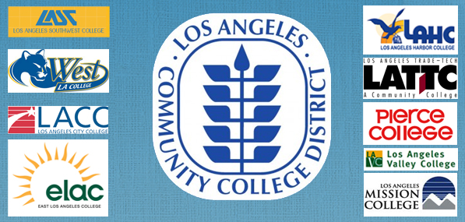
Art and Art History Discipline Committee of LACCD

Slide 3
Approved and Supported
Approved by the Academic Senate, Los Angeles Mission College
Seconded by Chloe Allred, Instructor of Art, Copper Mountain College
Letter of Support by the College Art Association

Slide 4
Current minimum qualifications
Master’s in fine arts, art, or art history
OR Bachelor’s in any of the above AND Master’s in humanities
OR the equivalent
(NOTE: “Master’s in fine arts” as used here refers to any master’s degree in the subject matter of fine arts, which is defined to include visual studio arts such as drawing, painting, sculpture, printmaking, ceramics, textiles, and metal and jewelry art; and also art education and art therapy. It does not refer to the “Master of Fine Arts” (MFA) degree when that degree is based on specialization in performing arts or dance, film, creative writing or other nonplastic arts.)

Slide 5
Revision to min qualification
Master’s in fine arts, or art, or art history
OR Bachelor’s in any of the above AND Master’s in humanities art history
OR the equivalent
(NOTE: “Master’s in fine arts” as used here refers to any master’s degree in the subject matter of fine arts, which is defined to include visual studio arts such as drawing, painting, sculpture, printmaking, ceramics, textiles, and metal and jewelry art; and also art education and art therapy. It does not refer to the “Master of Fine Arts” (MFA) degree when that degree is based on specialization in performing arts or dance, film, creative writing or other nonplastic arts.)

Slide 6
Rationale and Evidence
Art and Art History are distinct disciplines.
Prior to 2012 Art and Art History were considered one discipline on the California Community Colleges discipline list. Art History was added to the discipline list separate from Art in 2012.

Slide 7
Rationale and Evidence
Art known as studio art focuses on the creation of art. Currently, studio art can be taught by faculty with an Art History degree which typically includes little to no preparation in the creative and technical processes of making art.
This revision would ensure that art faculty are properly prepared.
Faculty with a Masters in Art History and a Bachelors in Art would be qualified to teach studio art classes.

Slide 8
Rationale and Evidence 2
The updated minimum qualifications will align more closely with hiring practices in public universities in California.
Evidence includes recent job announcements for Art Professors at CSU San Marcos, CSU Northridge, CSU Long Beach, San Francisco State University, and CSU Fresno.
All of these state that the minimum qualification to teach studio art is a Master of Fine Arts (M.F.A.) or the equivalent.

